Slide 1

Change Management Process – Tmcel
Change Management Process - Tmcel
EGI
Process Overview
Change Manager
01-7-2021

Slide 2
Agenda
What is Change Management Process?
Goals & Objectives
Types of Change Request
Change Request Lifecycle
MS Change Management Practice & Timelines
Q & A

Slide 3






Change Management Process
Change Management is a structured approach to ensure that changes are implemented smoothly and successfully to achieve lasting benefits.
Start
Change Requirement
Change Assignment
CAB & Approvals
Implementing Change
Post Implementation Review
Change Closure
Benefit Realization
Change Request
Audit
Prioritization
Execution
Risk assessment

Slide 4
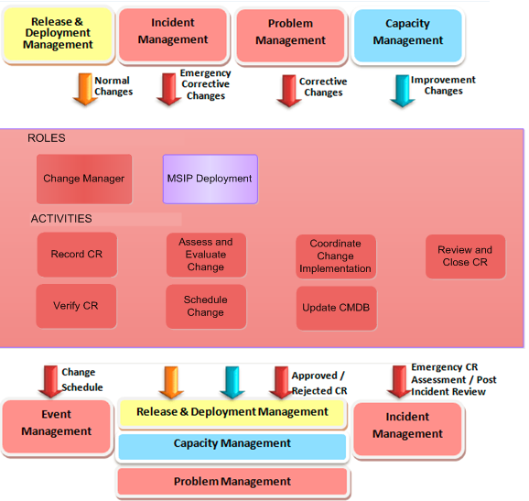
2.1 Goal of Change Management
The goal of Change Management is to support the need to prepare the customer's telecom and IS/IT infrastructure and service portfolio to meet its changing business requirements while protecting the customer's services - reducing outages, disruptions and re-works.
Triggers , Inputs & Outputs
Change Management must ensure that all changes:
Are justified
Have their requests properly recorded in the Change Management tool
Have their results properly recorded in the CMDB
Had their risks properly mitigated by analysis and testing
Have an adequate fallback plan
Notes:
Service Request Management Process. Service Requests are used to validate and authorise RFCs. Change data should be entered into the Change Management System as soon as an authorised RFC is received.
Incident Management. In the event of a disruption to service, to restore normal service operation and minimize impact on business operations. Escalation procedures within Incident Management are used to manage approvals for Emergency Changes.
Configuration Management. Checks if changes in the IT infrastructure have been reported correctly, including the relationship between CIs, and monitors the status of IT components to ensure it has an accurate picture of the version of CIs in existence. Change Management works with Configuration Management to establish the Change Baseline for CIs.
Problem Management. Proactive Problem Management is concerned with identifying and solving Problems and Known Errors before incidents occur in the first place. Correcting a Problem or Known Error may involve the raising of an RFC.
Release Management. Undertakes the planning, development, build, configuration, testing and deployment of Change items to create a set of release components that will be Baselined for an IT environment. The Project Management process for the large-scale rollout of hardware or software often initiates a release. A release can also typically consist of a number of problem fixes and enhancements to a service.
Service Level Management. Provides clear information on the service level or operational targets as agreed in the business contracts.
Capacity Management: Capacity management provides the required information to support the change planning requirements. Capacity Management is informed to the changes to infrastructure.
Continuity Management: Provide the input during the change planning activity and is informed regarding changes to infrastructure to support business service continuity.

Slide 5
2.2 Objectives
The objectives for Change Management are
To ensure that standardized methods and procedures are used for efficient and prompt handling of all Changes, in order to minimize the impact of change-related Incidents upon Service quality and improve the day-to-day operations of the Services.
To ensure that all Changes are effectively managed, thus reducing or eliminating disruptions to business services (Incidents) resulting from Change.
The benefits of Change Management process are
Reduced number of Incidents due to Changes
Improved visibility into unauthorized Changes
Improved managed of risks due to implementation of Changes
Reduce discrepancies with configuration
Delivers reduced errors in new or changed services and faster, more accurate implementation of Changes.
Notes:
Service Request Management Process. Service Requests are used to validate and authorise RFCs. Change data should be entered into the Change Management System as soon as an authorised RFC is received.
Incident Management. In the event of a disruption to service, to restore normal service operation and minimize impact on business operations. Escalation procedures within Incident Management are used to manage approvals for Emergency Changes.
Configuration Management. Checks if changes in the IT infrastructure have been reported correctly, including the relationship between CIs, and monitors the status of IT components to ensure it has an accurate picture of the version of CIs in existence. Change Management works with Configuration Management to establish the Change Baseline for CIs.
Problem Management. Proactive Problem Management is concerned with identifying and solving Problems and Known Errors before incidents occur in the first place. Correcting a Problem or Known Error may involve the raising of an RFC.
Release Management. Undertakes the planning, development, build, configuration, testing and deployment of Change items to create a set of release components that will be Baselined for an IT environment. The Project Management process for the large-scale rollout of hardware or software often initiates a release. A release can also typically consist of a number of problem fixes and enhancements to a service.
Service Level Management. Provides clear information on the service level or operational targets as agreed in the business contracts.
Capacity Management: Capacity management provides the required information to support the change planning requirements. Capacity Management is informed to the changes to infrastructure.
Continuity Management: Provide the input during the change planning activity and is informed regarding changes to infrastructure to support business service continuity.

Slide 6
Types of Change Request
Change Request Class | Description
Normal | A change that is reviewed and communicated at a weekly CAB meeting and is not an Emergency or standard. To be considered a normal change, the CRQ must be in “Request for change” status at least 2 business days before the CAB meeting and must have all the requirements completed at least 1 business day prior to the CAB meeting.
Emergency | An unplanned and unforeseen change,necessary to restore a service or prevent disruption to the IT environment and used to address an emergency
Standard | A change request to the infrastructure that follows an established path, is relatively common and is the accepted solution to a sepcific requirement. These type of changes are preapproved,low risk,low impact and follow a standard procedure of work instructions. The change request must be executed successfully as a Normal change.

Slide 7
3.2 Change Impact , Urgency & Priority
Severity Definitions for a change
High/Critical Risk - Any of the existing running service have to bring down to implement the change, including service outage
Medium Risk - Redundancy of the existing running service have to bring down to implement the change.
Minor Risk - Changes in supporting application modules that do not impact any of the business continuity.
Change Impact
Minor/Localized. Extremely low impact to the business and/or requiring few ‘build’ resources.
Moderate/Limited. Moderate impact to the business and/or requiring multiple resources to implement.
Significant/Large. Large impact to the business and IT and/or requiring several resources to implement.
Extensive/Widespread. Major impact to the business and IT and/or requiring a very large amount of build resources to implement.
Change Priority
Low. A Change is justified and necessary but can wait until the next scheduled Release or upgrade.
Medium. No severe impact to the business, change can be pushed back if necessary.
High. Severely affecting some users or impacting upon a large number of Users. To be given highest priority for Change building, testing and implementation resources.
Critical. Causing loss of service or severe usability problems to a larger number of users, a mission-critical system, or some equally serious problem. Immediate action required.
Priority indicates the relative order in which to address the changes. It should be influenced by considerations of risk and resource availability, but primarily is driven by the combination of Impact and Urgency. Priority calculation is based on Impact and Urgency.
Notes:
The conditions for Change Impact are typically driven by the number of affected users but could also relate to the affected business processes and/or technical services.

Slide 8

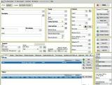
4.1 Normal Change Request lifecycle
Discuss and Evaluate Changes
Impact Analysis (SME,BA,ADM, SRF, OPS)
CAB Approve CR or Reject CR
CR Scheduled For Implementation
9
CAB
6
7
Customer Network
Change Manager to Set up CAB.
Invite all stakeholders related to the Change
ITSM CM
8
5
CR Implemented
Update the Outcome in ITSM tool
Implementer to get Incident raised in case of unresolved issues and update in ITSM tool
Change Manager
CR Approved in CAB and is Scheduled
3
Change Manager
10
Basic Sanity Checks
Review CR By Change Manager
Perform Validations
Using ITSM Tool
4
Change Manager performs Post Implementation Review
Change Requested By Initiator Teams
Post Implementation Review By Change Manager
Approve PIR if CR implemented successfully
Ensure Incident details are present if issues observed whilst implementation
1
Change Request
2
Customer Network
Change Requester(ADM, OPS, SRF, SOC)

Slide 9
4.2 Standard Change Request lifecycle
CR Scheduled For Implementation
6
3
5
Customer Network
ITSM CM
Change Manager
7
Basic Sanity Checks
Review CR By Change Manager
Perform Validations with Standard
CR catalogue
Check relevant approval/s
CR Implemented
Update the Outcome in ITSM tool
Implementer to get Incident raised in case of unresolved issues and update in ITSM tool
CR Approved in ITSM tool & Scheduled
Using ITSM Tool
4
8
Change Manager performs Post Implementation Review
Change Requested By Initiator Teams
Post Implementation Review By Change Manager
Approve PIR if CR implemented successfully
Ensure Incident details are present if issues observed whilst implementation
1
Change Request
2
Customer Network
Change Requester(ADM, OPS, SRF, SOC)

Slide 10
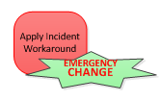

4.3 Emergency Change Request lifecycle
CR Scheduled For Implementation
3
2
Customer Network
ITSM
5
Change Requested By Initiator Teams
4
CR Approved in ITSM tool & Scheduled
ECR Implemented
Services back to normal
Incident Closed
Update the Outcome in ITSM tool
Implementer to get Incident raised in case of unresolved issues and update in ITSM tool
2
Change Requester(Operations Team)
1
Customer Network

Slide 11
5.1 Deliverables of MS Change Manager
Support in creation of Change request
Change request validation and sanity check
Prioritization among change requests.
Clash check among planned changes
Organize CAB meeting
Notification of the change to ensure visibility
Change execution status update

Slide 12
Change Creation Process
Need to submit all the Change request to this email id by Friday
change.management.mobily@ericsson.com
Need data in given format ( all green boxes need to be filled)
change Request.xlsx

Slide 13
5.3 Normal Change high level schedule
Monday 12 PM
Prepare the list of activities as per priority to be implemented next week
(Done by requestor)
Tuesday
Change Requester group to register all CR´s in ITSM tool
CPMs to request Resources (online/oncall)
Wednesday Customer CCB
CR scheduled for implementation
Internal CAB would be executed, and all changes would be discussed

Slide 14
5.4 Change Request approval Stages & Authorities
1
CUSTOMER CAB
2
OA HEAD
3
HUB HEAD
4
ERICSSON CAB Discussion
5
CM Approval

Slide 15

5.5 Prerequisites for implementation of a Change
UAT Signoff
3PP connectivity to be established with production
Signed ready for production deployment
Approval from all approvers to be secured
Securing all the resources in advance as per the process
Infra resources to be secured for the entire week on every Monday
Activity MOP and Rollback plan
Activity Risk and mitigation plan
Tester Alignment

Slide 16
Q & A

